Slide 1

Analyzing Adult Income Dataset
Abirami baskaran

Slide 2
Dataset
An individual’s annual income results from various factors. Intuitively, it is influenced by the individual’s education level, age, gender, occupation, and etc.
The dataset contains 16 columns Target filed: Income -- The income is divided into two classes: 50K Number of attributes: 14 -- These are the demographics and other features to describe a person
Acknowledgements This dataset is found in the Kaggle repository https://www.kaggle.com/wenruliu/adult-income-dataset
The detailed description on the dataset can be found in the original UCI documentation http://www.cs.toronto.edu/~delve/data/adult/adultDetail.html
Reference: https://www.kaggle.com/rblcoder/analyzing-earning-dataset

Slide 3
Dataset Description
age: continuous.
workclass: Private, Self-emp-not-inc, Self-emp-inc, Federal-gov, Local-gov, State-gov, Without-pay, Never-worked.
fnlwgt: continuous.
education: Bachelors, Some-college, 11th, HS-grad, Prof-school, Assoc-acdm, Assoc-voc, 9th, 7th-8th, 12th, Masters, 1st-4th, 10th, Doctorate, 5th-6th, Preschool.
education-num: continuous.
marital-status: Married-civ-spouse, Divorced, Never-married, Separated, Widowed, Married-spouse-absent, Married-AF-spouse.
occupation: Tech-support, Craft-repair, Other-service, Sales, Exec-managerial, Prof-specialty, Handlers-cleaners, Machine-op-inspct, Adm-clerical, Farming-fishing, Transport-moving, Priv-house-serv, Protective-serv, Armed-Forces.
relationship: Wife, Own-child, Husband, Not-in-family, Other-relative, Unmarried.
race: White, Asian-Pac-Islander, Amer-Indian-Eskimo, Other, Black.
sex: Female, Male.
capital-gain: continuous.
capital-loss: continuous.
hours-per-week: continuous.
native-country: United-States, Cambodia, England, Puerto-Rico, Canada, Germany, Outlying-US(Guam-USVI-etc), India, Japan, Greece, South, China, Cuba, Iran, Honduras, Philippines, Italy, Poland, Jamaica, Vietnam, Mexico, Portugal, Ireland, France, Dominican-Republic, Laos, Ecuador, Taiwan, Haiti, Columbia, Hungary, Guatemala, Nicaragua, Scotland, Thailand, Yugoslavia, El-Salvador, Trinadad&Tobago, Peru, Hong, Holand-Netherlands.
class: >50K, <=50K

Slide 4
Problem Statement
We can explore the possibility in predicting income level based on the individual’s personal information.

Slide 5
Data Cleaning
Check for duplicate values using .duplicated()
Drop them using .drop_duplicates(keep = False)
Replace unwanted characters with “unknown”

Slide 6
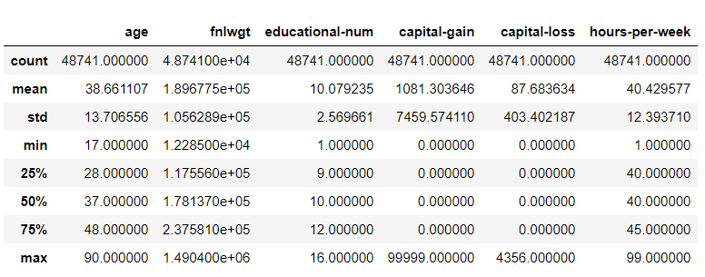
Statistical Description
The describe() function generate descriptive statistics that summarize the central tendency, mean, percentile, dispersion and shape of a dataset’s distribution, excluding NaN values.

Slide 7
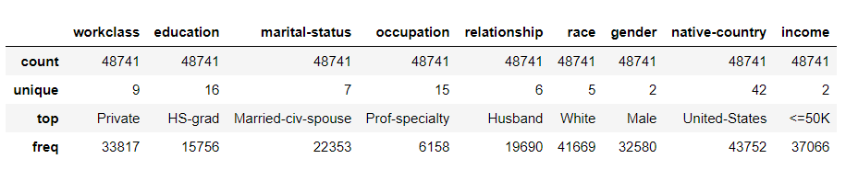
Statistical Description of Categorical data's
It describes the shape of the dataset, unique, top valuesof the features and frequency of occurrence.

Slide 8
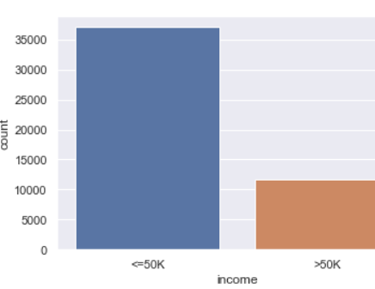
Target variable - Income
76.5% : <=50k
23.5%: >50k

Slide 9
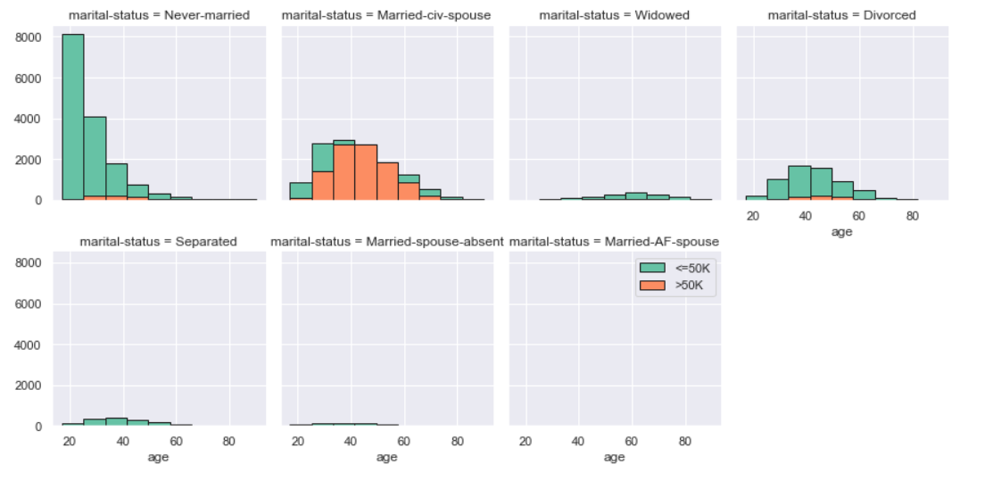
Marital-Status
Unmarried people have got <=50k income. Most of the people at the age between 10 to 25 have got <=50k compared to the age between 35 and 60.
Married people from the age between 35 and 55 have got >50k income.

Slide 10
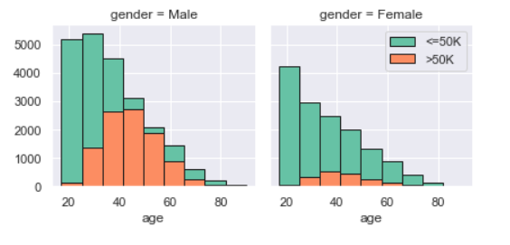
Male at the age between 10 and 25 have earned <=50k. From the age of 25 to 50 the percentage of earning >50k is higher. When we speak about Female almost 90% of them have earned <=50k. The ratio of earning >50k is much lower when compared to Male.
Gender

Slide 11
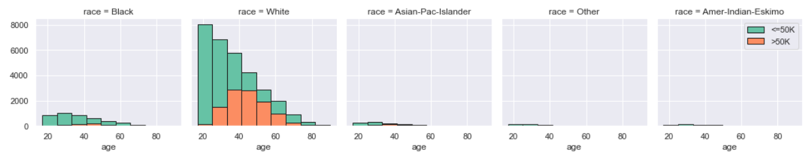
White race earning good salary compared to all other races. The ratio of earning >50k has been increasing from the age 25 to 50.
Race

Slide 12
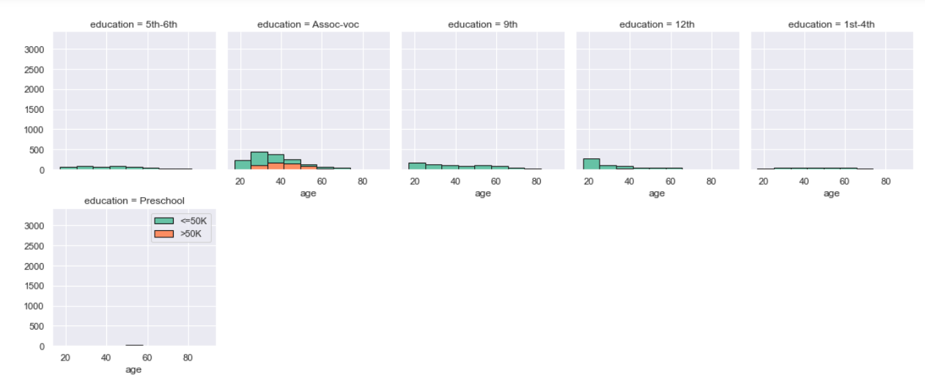
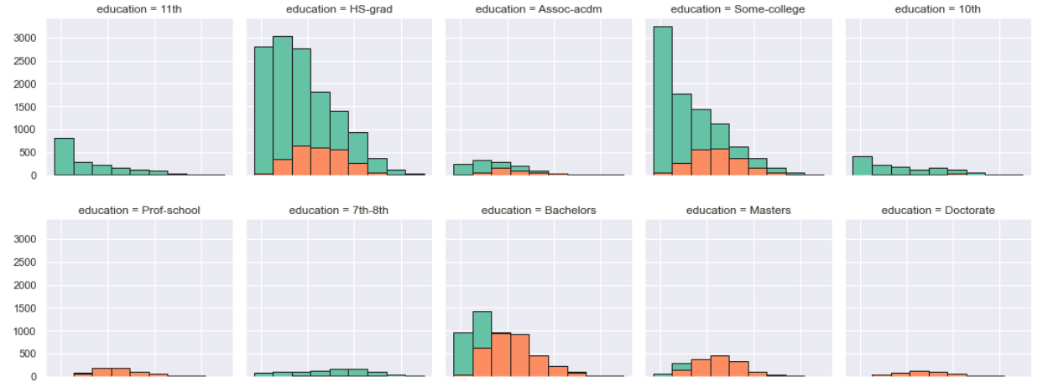
Education
Few numbers of people who have Bachelors, Masters, Prof-school, and Doctorate degree have been earning >50k income.
Larger numbers of people who have HS-grad, and college degree have been earning <=50k and <30% of people earning >50k.

Slide 13
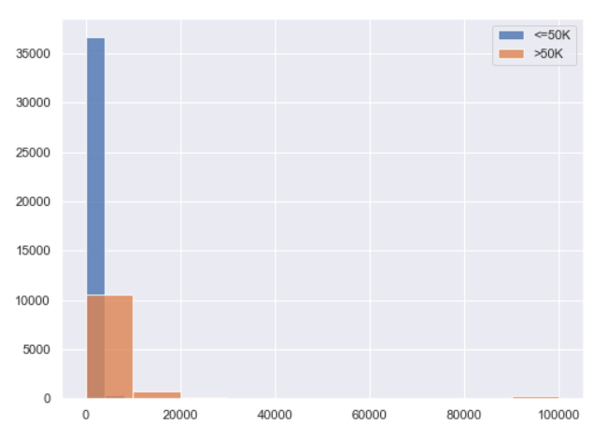
Capital gain Vs Income

Slide 14
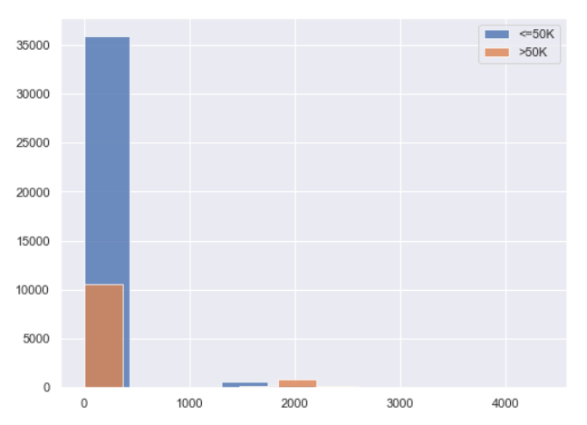
Capital loss Vs Income

Slide 15
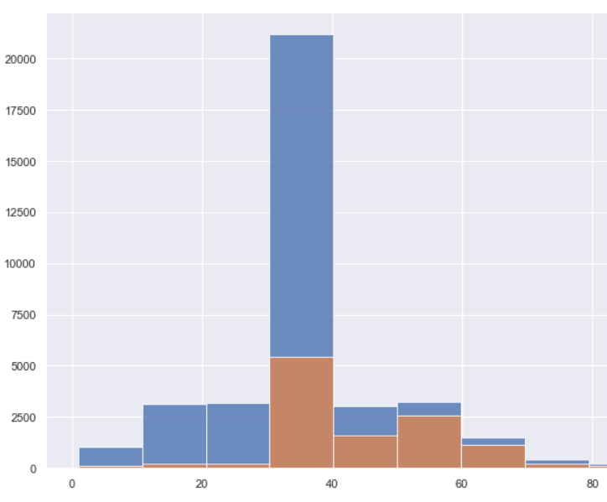
Hours-per-week Vs Income
Blue bar indicates <=50k income
Orange bar indicates >50k income

Slide 16
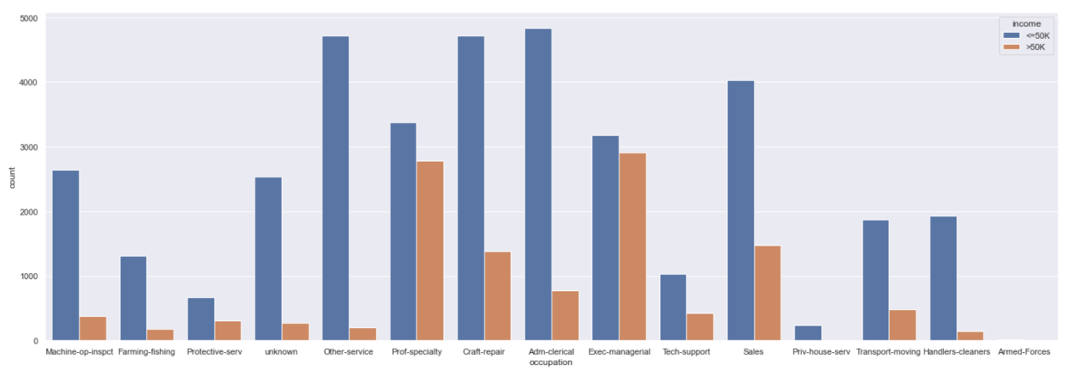
People who are in the position of Executive, speciality in profession, sales person, and craft-repair have been earning >50k.
Occupation

Slide 17
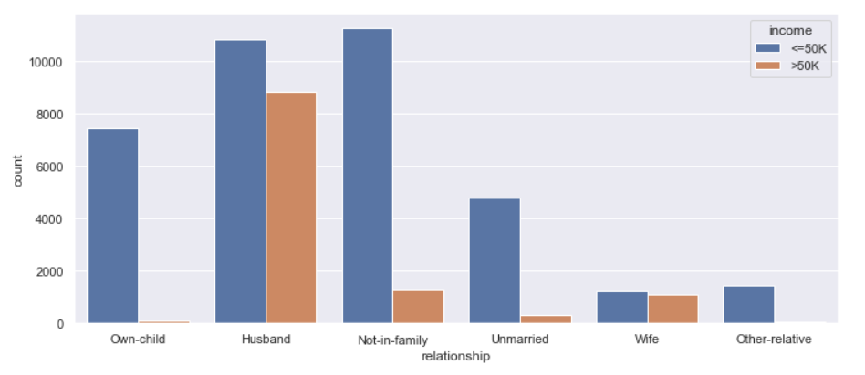
Relationship Vs Income

Slide 18
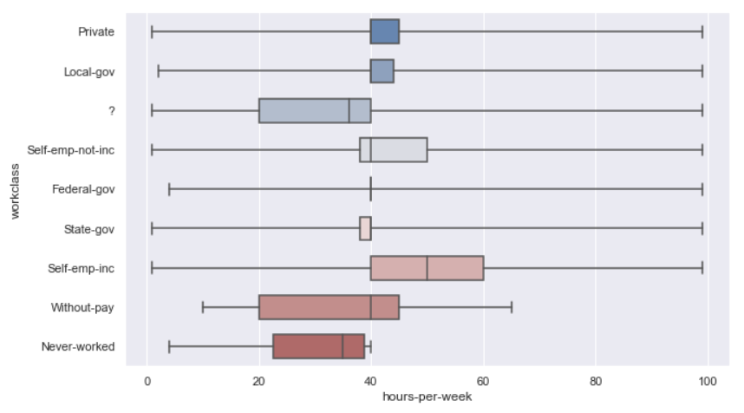
Work class
State, and Federal government employees working 40 hours per week.
Private and local government employees working 40 to 45 hours per week.
Self-employees who are getting income working 40 to 60 hours per week.
Self-employees who are not getting income working 38 to 50 hours per week.

Slide 19
Conclusion
There is a gender inequality to give salary to the people. (i.e.., male getting more salary than female who are in the same age.
White people getting more income than other races.
Degree holders like masters, doctorate, bachelors, and prof-school earning >50k.
Executives, sales person, specialist earning >50k.
People who are working 40 to 60 hours earning >50k, but few in numbers.

Slide 20
GitHub link
https://github.com/abiakshar/Externship/blob/main/adult_income%20.ipynb

